Slide 1
The knapsack problem (3D)
Group 8
Adam Eljasiak
Daniel Kaestner
Simon Wengeler
Raffaele Piccini
Nicola Gheza
Henri Viigimäe

Slide 2
CONTENTS
1. Assignment description
2. Assignment results
3. Implemented algorithms
4. Experiments and results
5. Conclusions

Slide 3
ASSIGNMENT DESCRIPTION

Slide 4
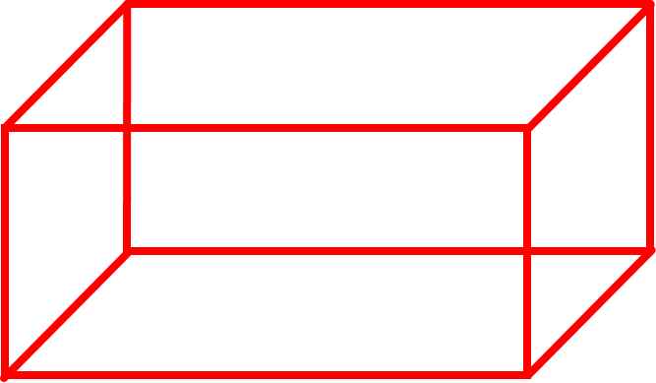
Application for solving three-dimensional knapsack problems
Three packages with certain values and a cargosace
A: 1.0 x 1.0 x 2.0 (m) with a value of 3
B: 1.0 x 1.5 x 2.0 (m) with a value of 4
C: 1.5 x 1.5 x 1.5 (m) with a value of 5
Cargospace: 16.5 x 2.5 x 4.0 (m)
16.5 (m)
4 (m)
2.5 (m)

Slide 5
ASSIGNMENT RESULTS

Slide 6
No solution to filling the entire cargo space with A,B and/or C packages has been found.
Best result found for maximizing a single packing: 240
Number of A packages: 30
Number of B packages :10
Number of C packages: 22

Slide 7
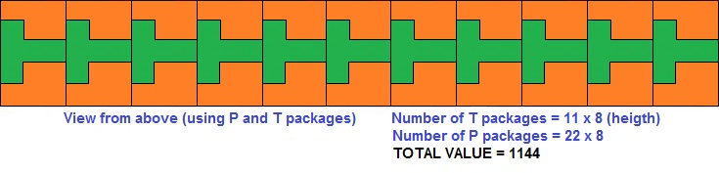
It is possible to fill the entire cargospace with L,P and/or T packages.
Best result found for maximizing a single packing: 1144

Slide 8
GREEDY ALGORITHM

Slide 9
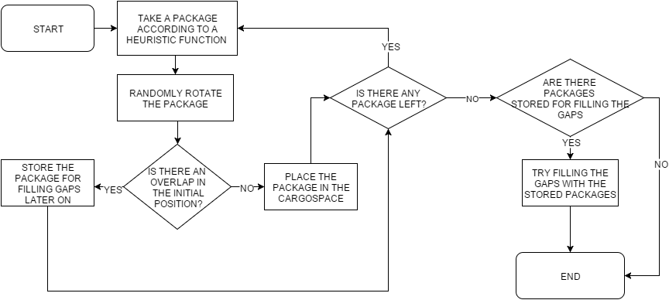

Slide 10
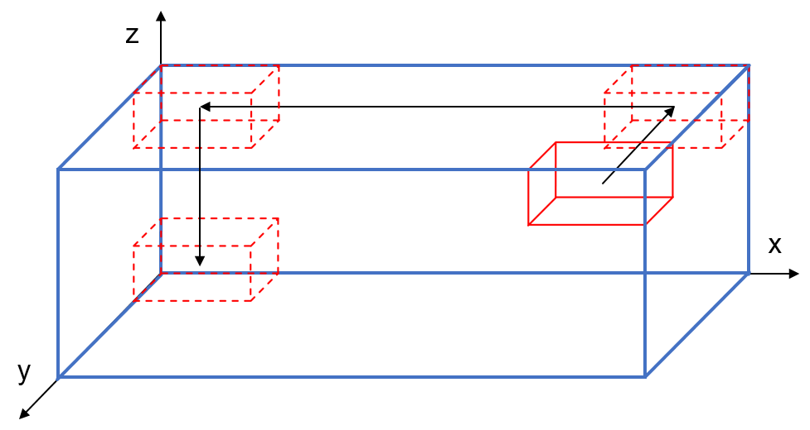
Initial position
Is there an overlap at the initial position?
Move package

Slide 11
HILL CLIMBING ALGORITHM

Slide 12
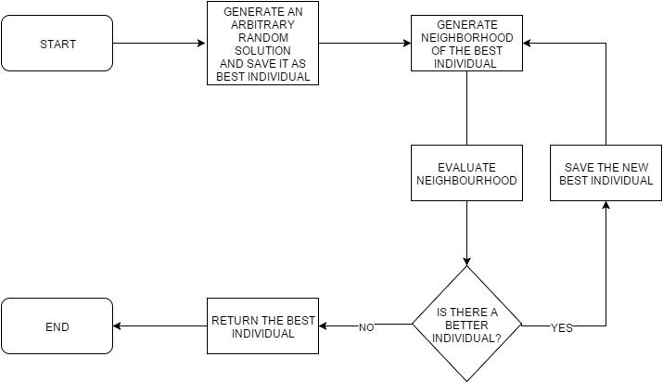

Slide 13
GENETIC ALGORITHM

Slide 14
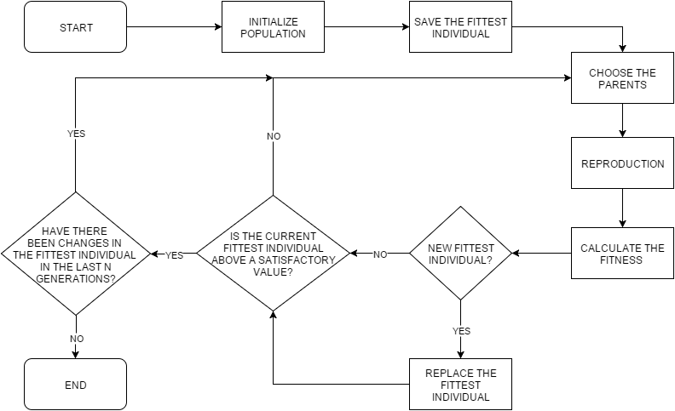

Slide 15
EXPERIMENTS AND RESULTS

Slide 16
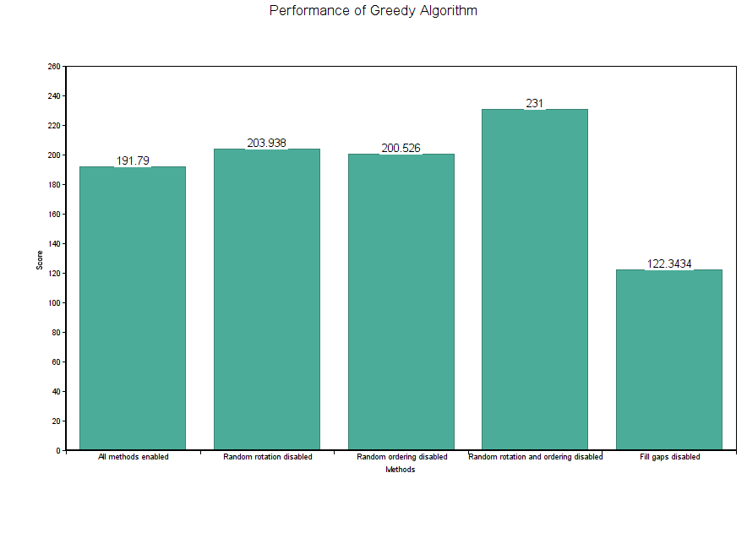
EXPERIMENTS AND RESULTS (GREEDY ALGORITHM)
Finding the best total value
30 packages
1000 runs

Slide 17
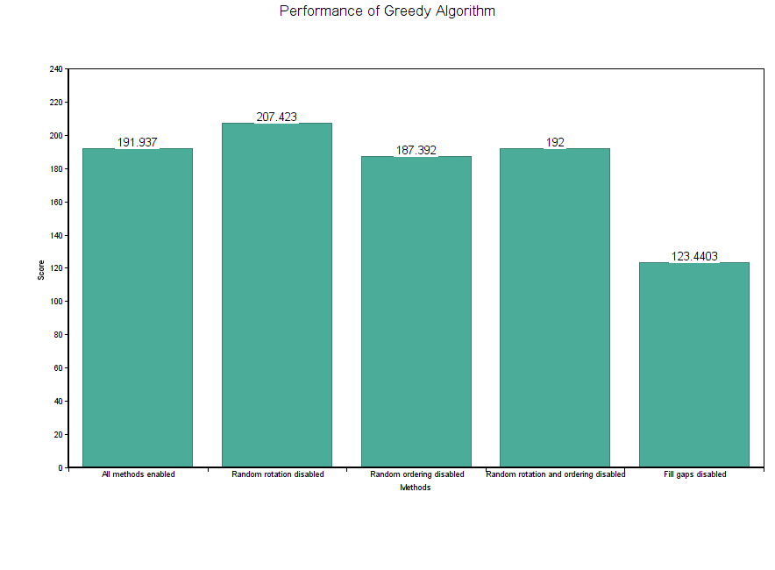
Finding the best total value
100 packages
1000 runs

Slide 18
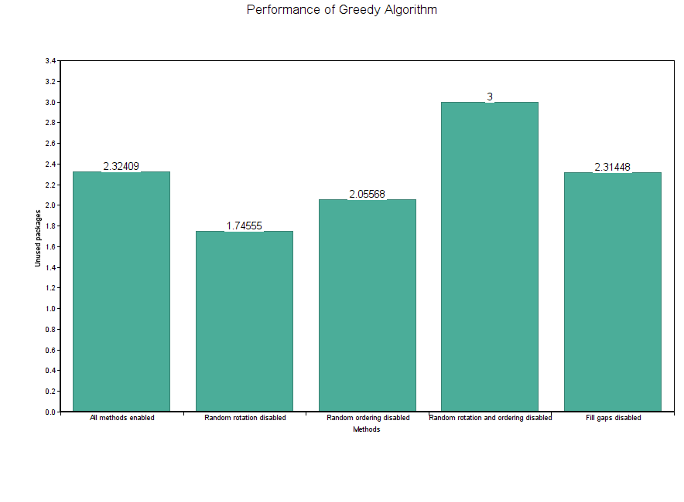
Packages that remain unused
10 packages
100000 runs

Slide 19
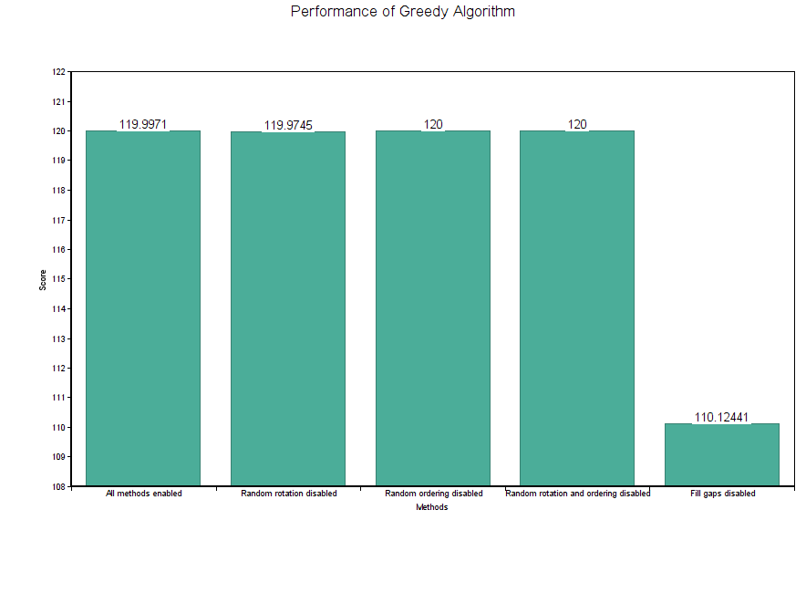
Finding the best total value
10 packages
100000 runs

Slide 20
EXPERIMENTS AND RESULTS (HILL CLIMBING)

Slide 21
Increase in mutation
Better average value
Longer runtime
Increasing the neighbourhood size has no significant affect after a certain point

Slide 22
EXPERIMENTS AND RESULTS (GENETIC ALGORITHM)

Slide 23
Increase in population size yields better results
Affects the tournament selection method the most
Large increase in the average result achieved
Significant decrease in runtime

Slide 25
Increasing the mutation probability decreases the performance of the algorithm (both value and runtime wise)
This could be due to the way best solution is achieved (no rotations)

Slide 26
EXTERNAL FACTORS
Experiments with different number of packages and new package types
No correlation between performance and certain package shapes
Genetic algorithm has the best performance

Slide 27
CONCLUSIONS

Slide 28
Greedy algorithm is the fastest but does not perform as well as other algorithms.
Hill climbing algorithm achieves good results but might get stuck.
Genetic algorithm is time consuming and has a lot of parameters that need to be taken into account (difficult to implement) but it gets closest to the optimal solution.
CONCLUSIONS:
For the quickest solution: Greedy algorithm
For reasonably fast and good solutions: Hill Climbing algorithm
For the optimal solution: Genetic Algorithm

